Slide 1
Mission: We compassionately serve those in need, strengthen individuals and families, and advocate for the common good.

Slide 2
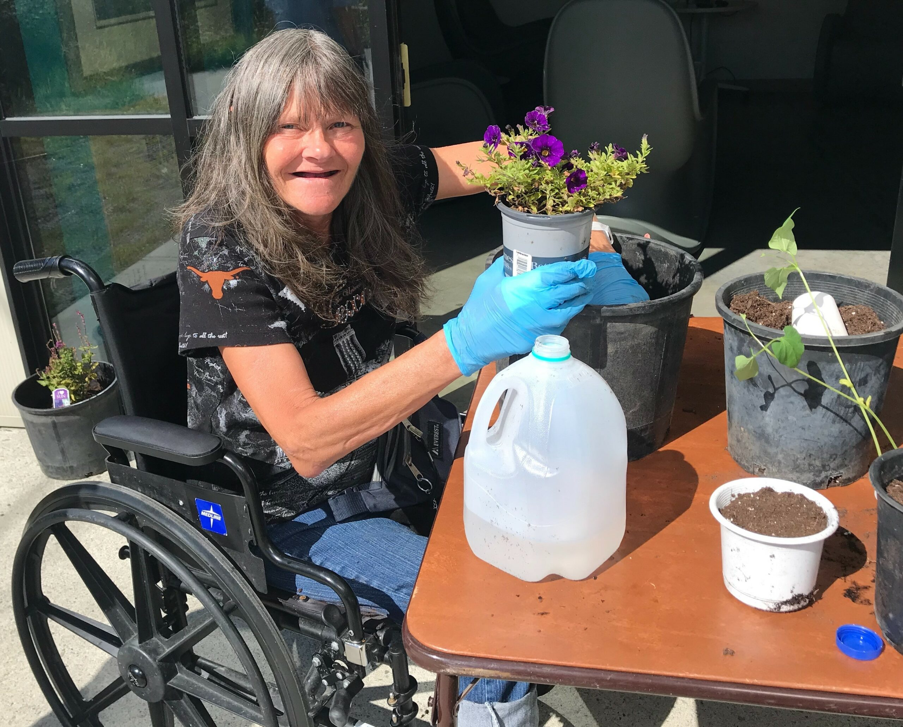
^{Heading}
content

Slide 3
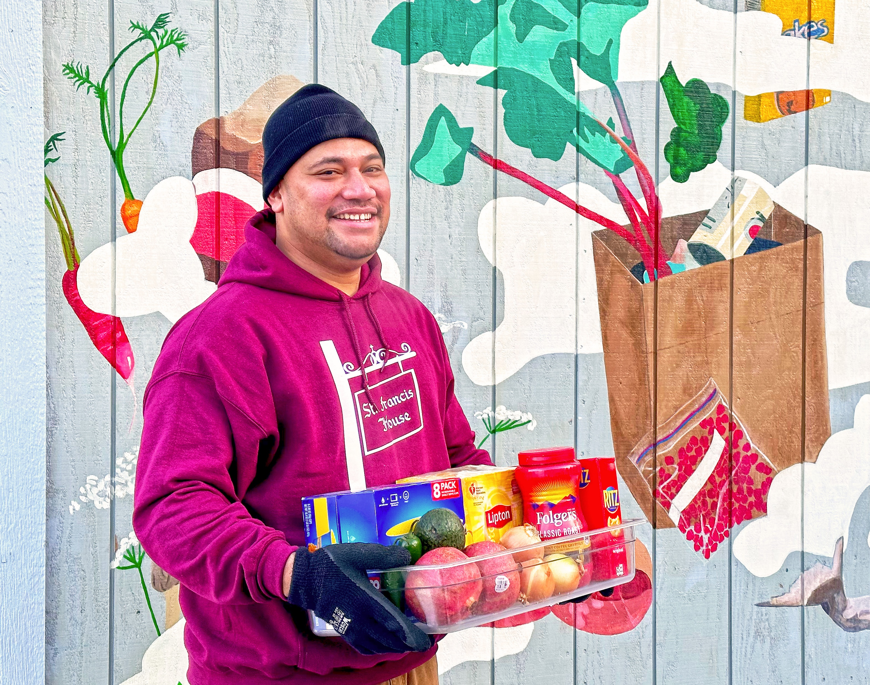
^{Heading}
^{subheading}
content

Slide 4
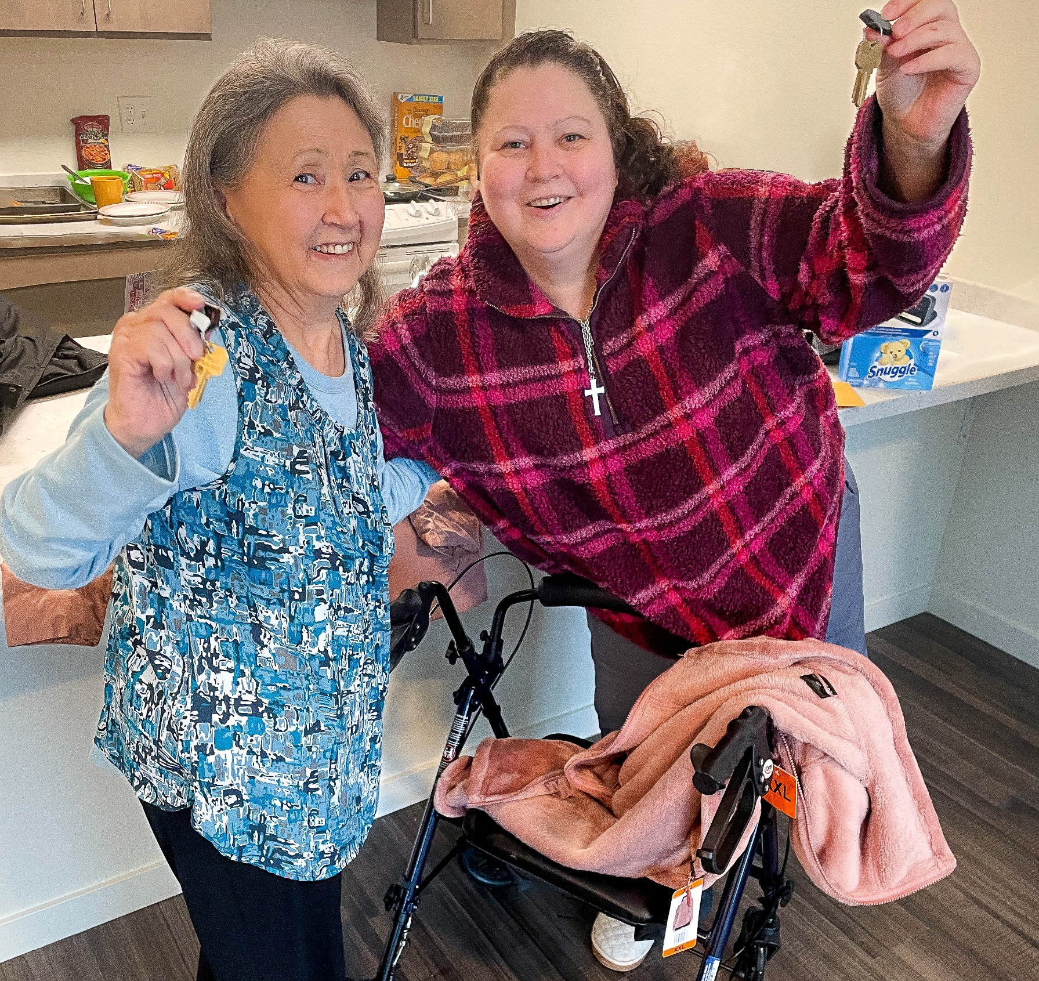
^{Heading}
content

Slide 5
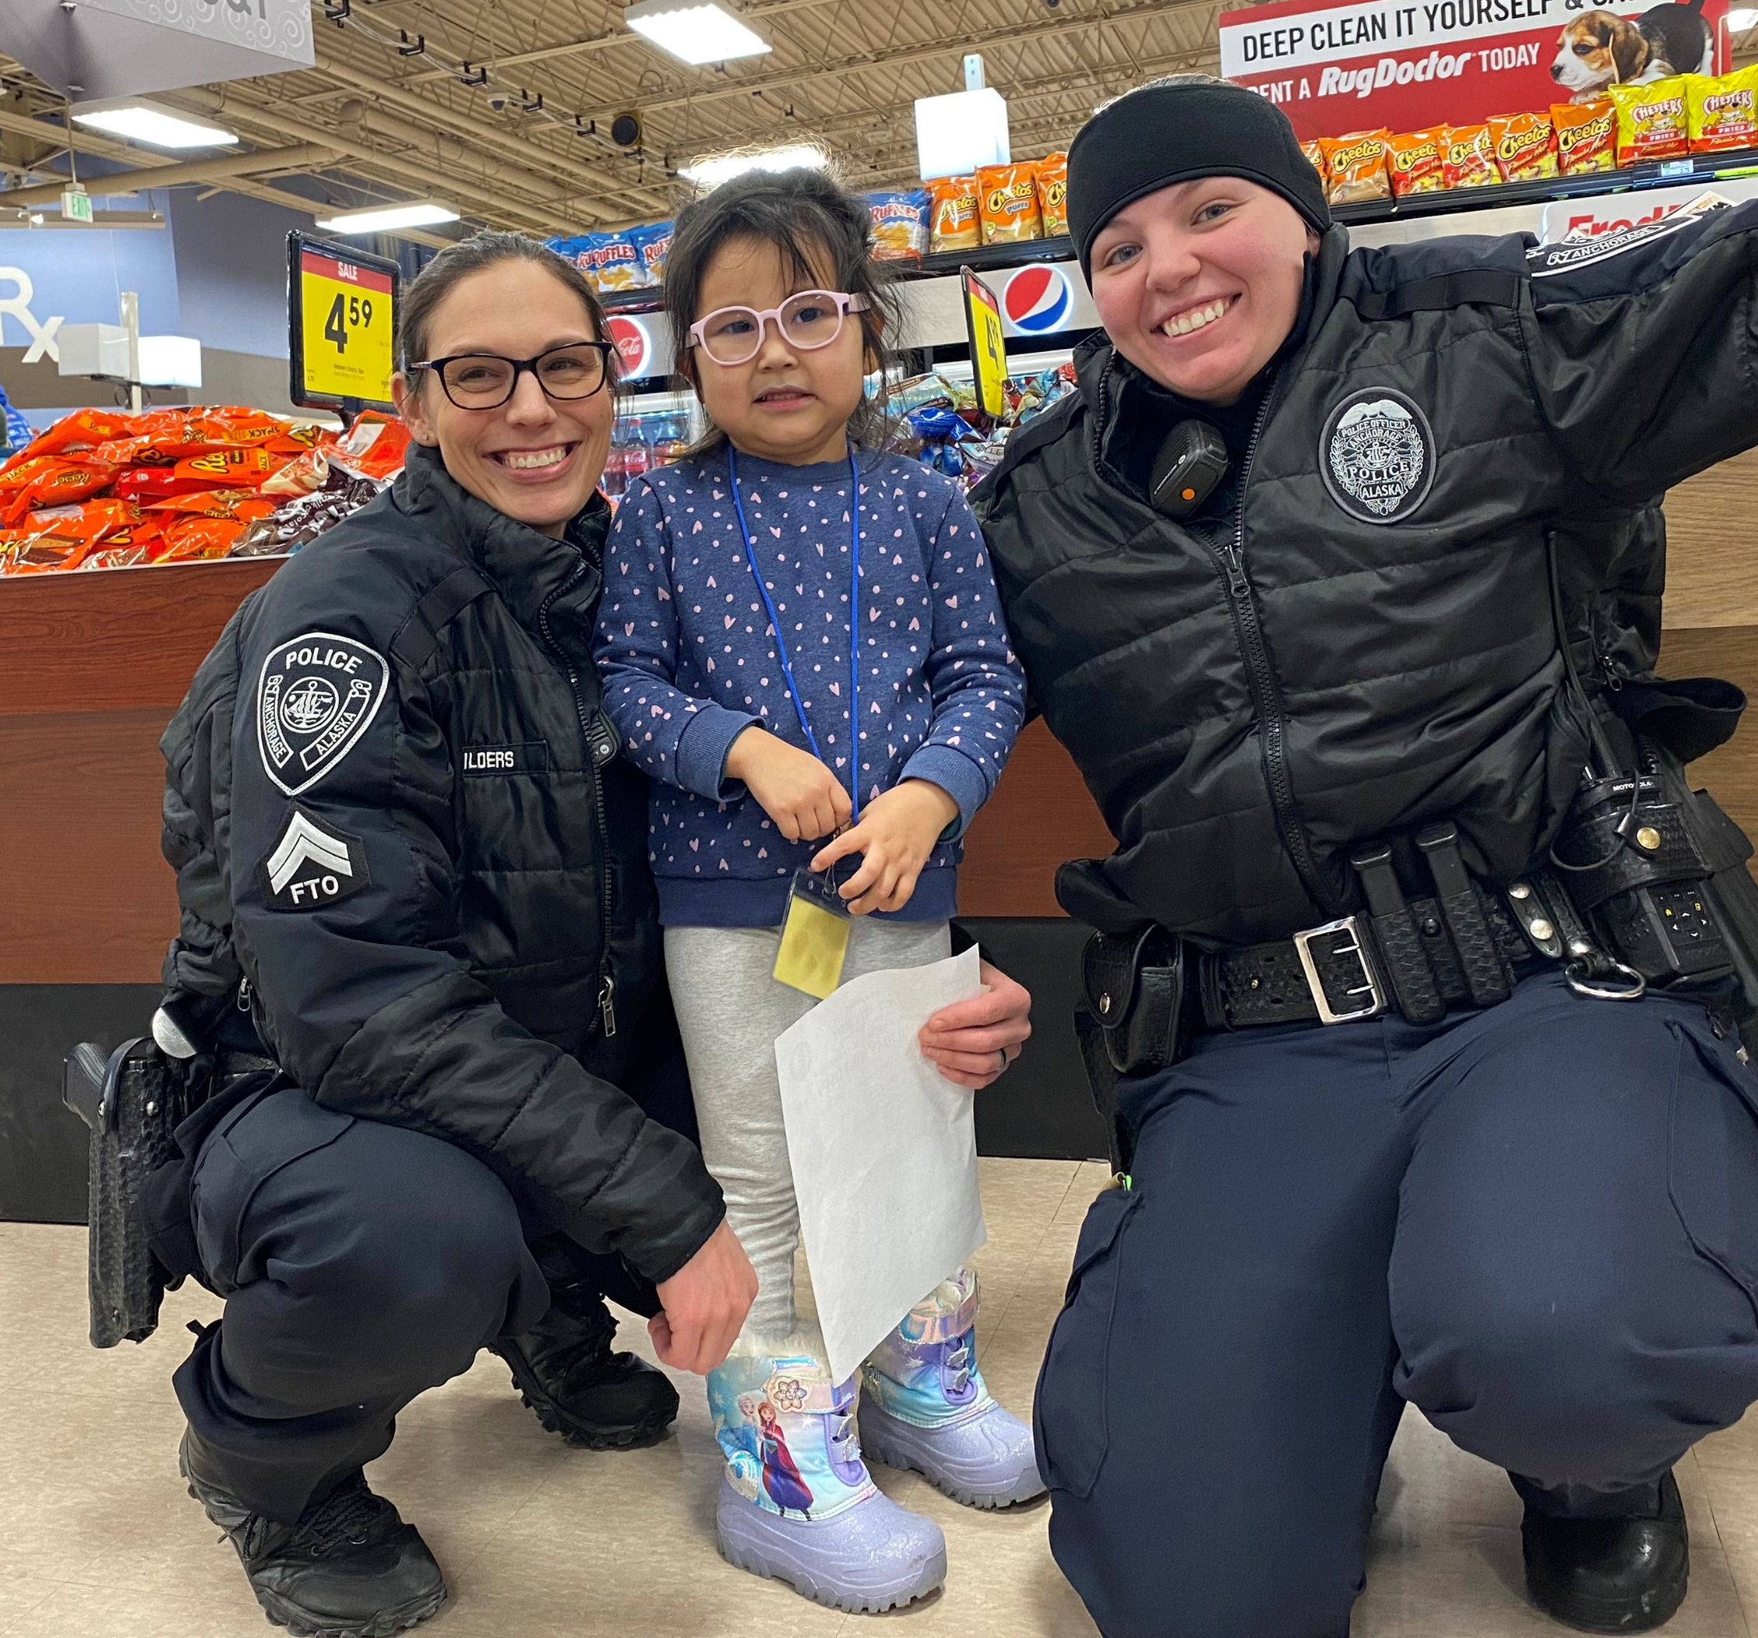
^{Heading}
content

Slide 6
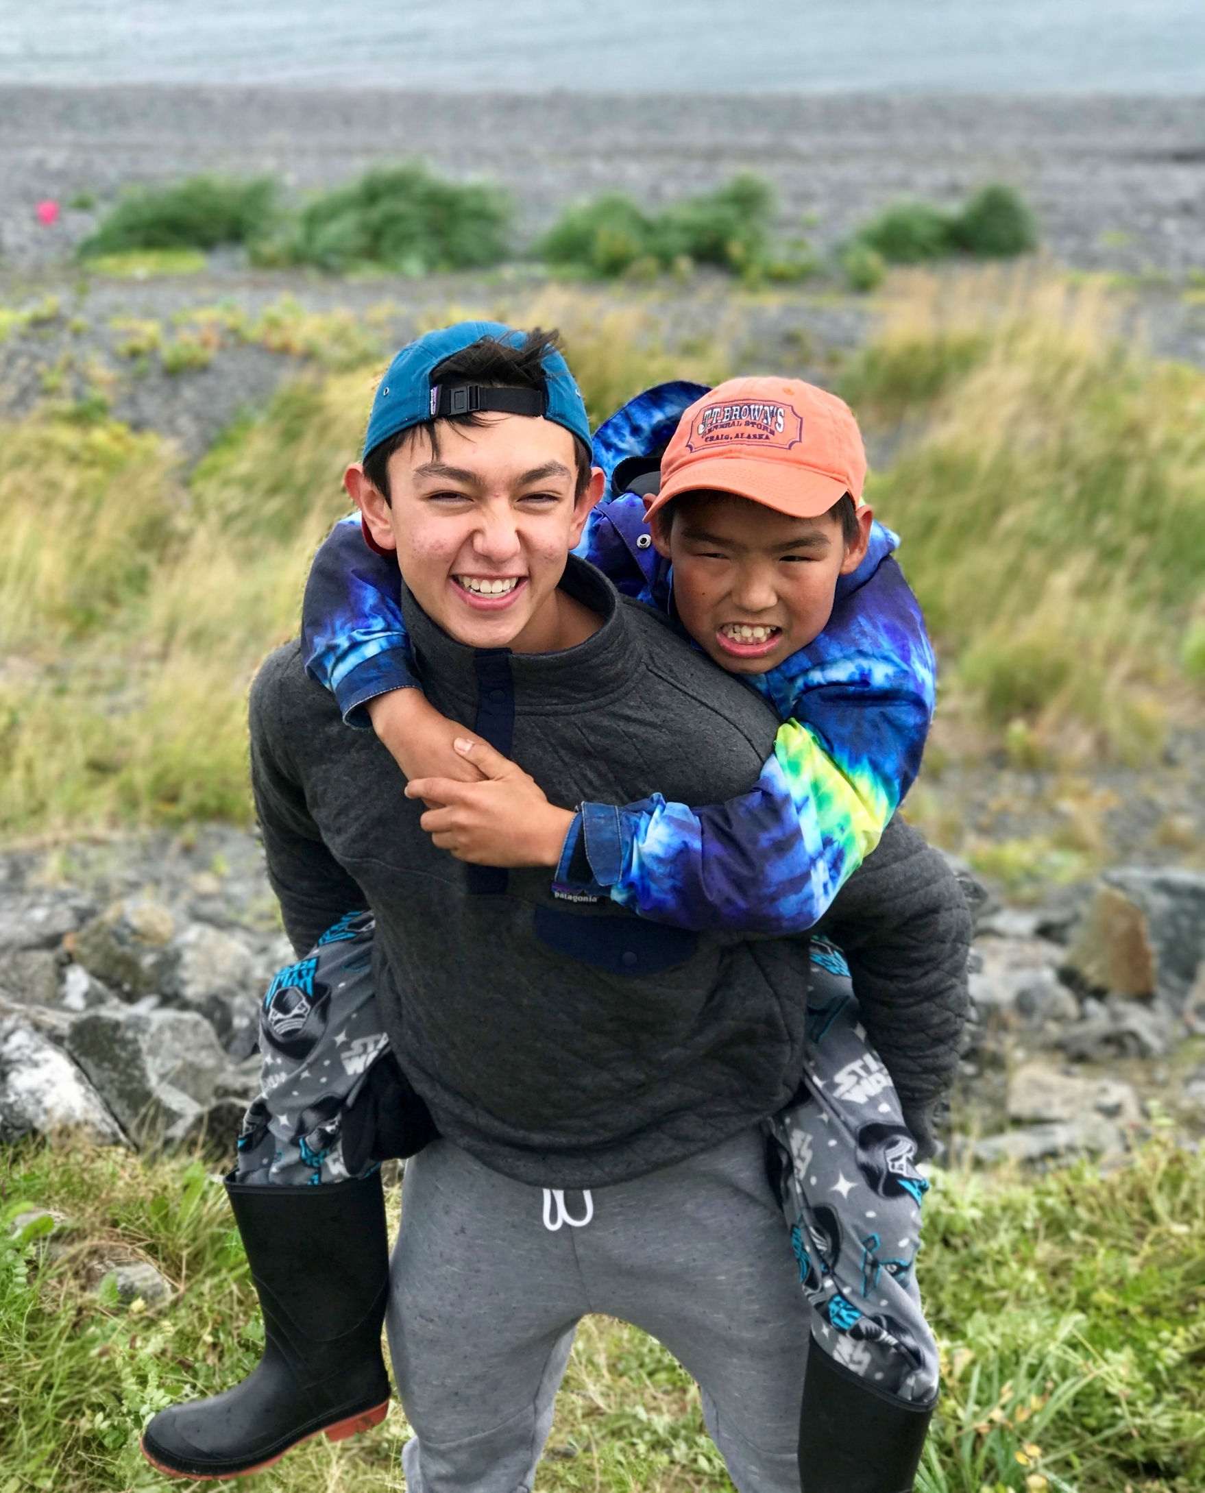
^{Heading}
content

Slide 7
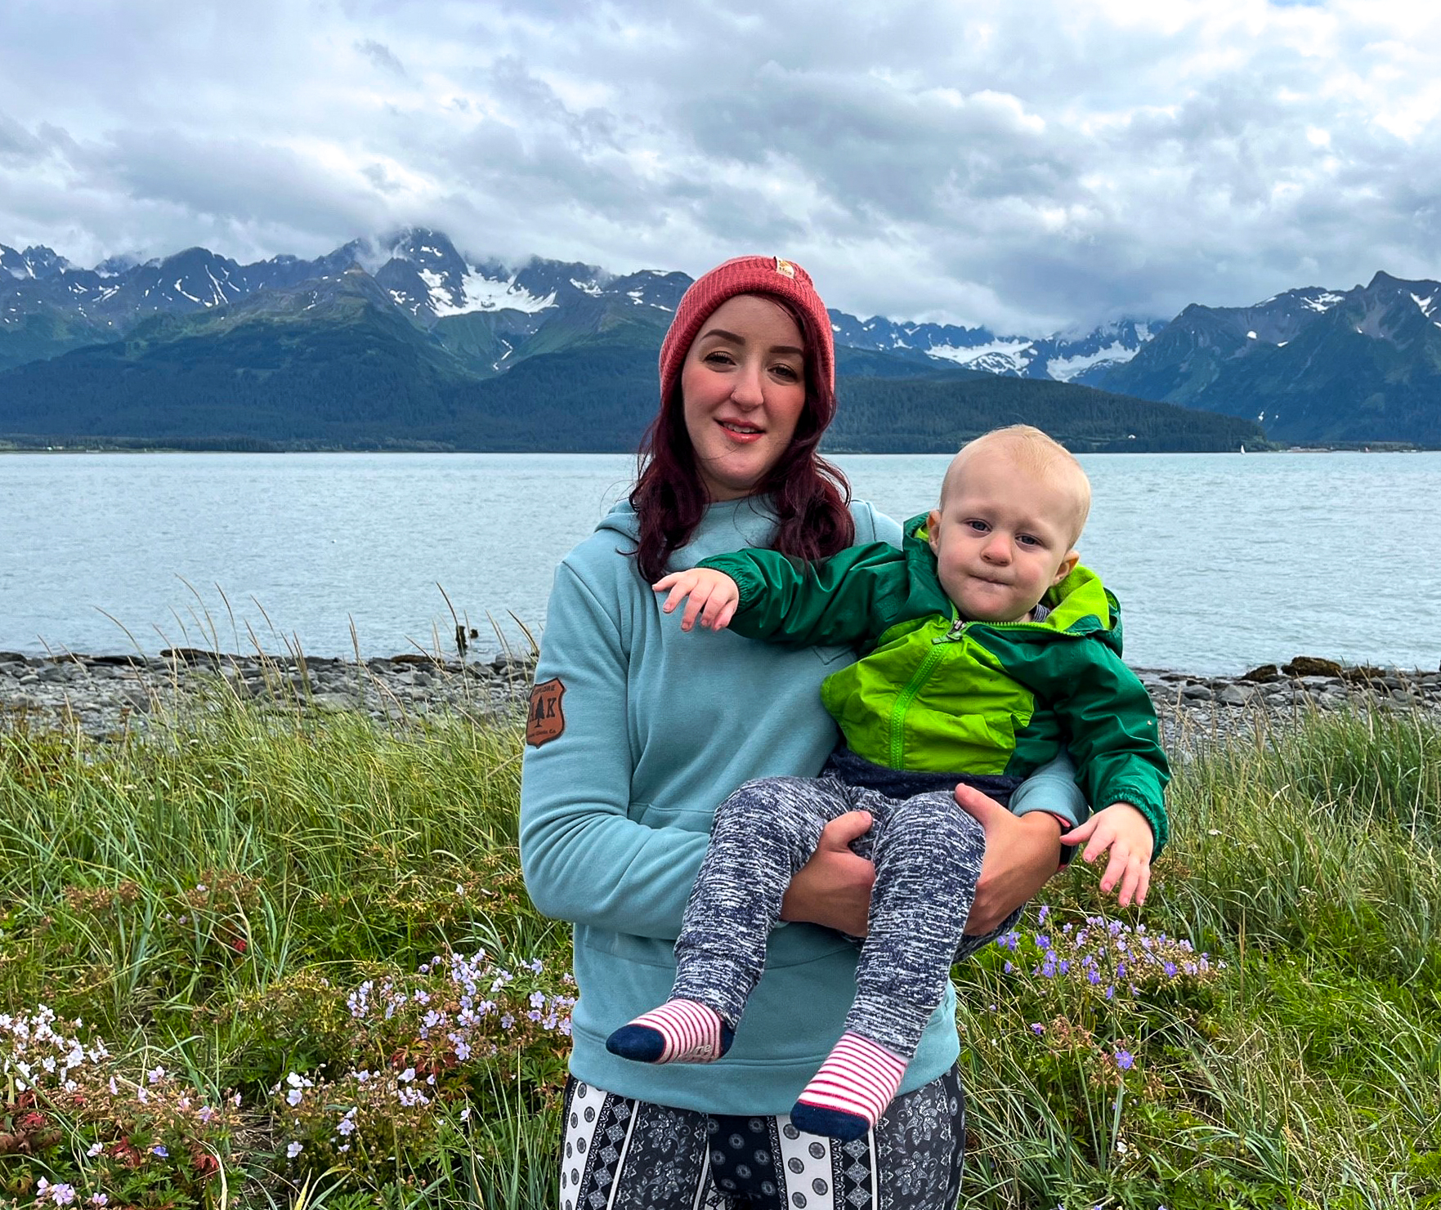
^{Heading}
content

Slide 8
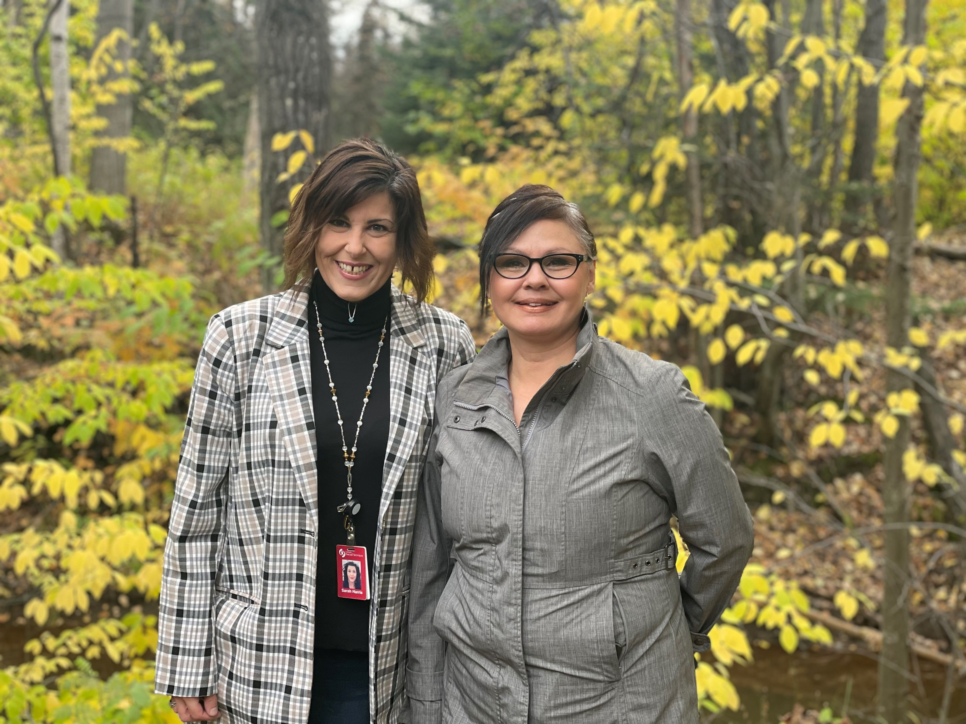
^{Heading}
content

Slide 9
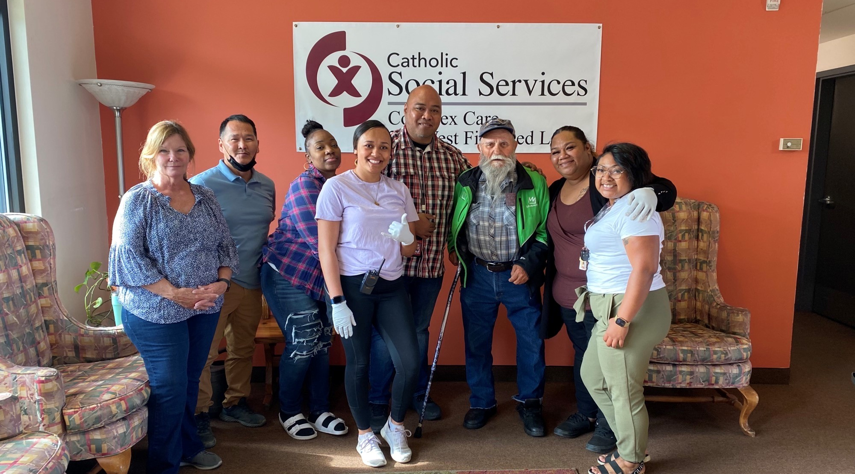
^{THANK YOU}

